Slide 1




STOCK DATA

Slide 2
Team Member
Name | ID
فرح اسامة رؤوف عبد القادر | 20201700577
ماهيتاب احمد محمد نجيب | 20201700644
فرح محمد ابراهيم السيد | 20201700581
مريم احمد ثابت علي | 20201700802
فيلوباتيراشرف رضا راغب | 20201700591

Slide 3
Dataset Description
The Yahoo Finance Stock Dataset is a comprehensive collection of stock market data pertaining to four prominent companies: AAPL (Apple Inc.), AMZN (Amazon.com Inc.), TSLA (Tesla Inc.), and GOOG (Alphabet Inc., Google's parent company). The dataset covers a period from November 20, 2018, onwards, providing daily records of stock prices and trading volume for these companies.

Slide 4
Attributes Description
DATE
THE DATE FOR WHICH THE STOCK MARKET DATA IS RECORDED.
OPEN
THE OPENING PRICE OF THE STOCK ON A GIVEN TRADING DAY.
HIGH
THE HIGHEST PRICE OF THE STOCK REACHED DURING THE TRADING DAY.
LOW
THE LOWEST PRICE OF THE STOCK REACHED DURING THE TRADING DAY.
CLOSE
THE CLOSING PRICE OF THE STOCK ON A GIVEN TRADING DAY.
ADJ CLOSE
THE ADJUSTED CLOSING PRICE OF THE STOCK, CONSIDERING DIVIDENDS, STOCK SPLITS, ETC.
VOLUME
THE TRADING VOLUME OF THE STOCK ON THE SPECIFIED DATE.
THE TICKER SYMBOL REPRESENTING THE RESPECTIVE COMPANY (AAPL, AMZN, TSLA, GOOG).
COMPANY

Slide 5
1- change date column format to date type.
2- encode the values of company column by 4 unique values.
preprocessing
3- split numeric columns that need to and then loop over them and round up every value that has float part greater than or equal to 0.5 and round down every float part that has value less than 0.5 and then change it’s type to integer.
4- then apply user-defined function called remove that removes the outliers from the numeric columns.

Slide 6

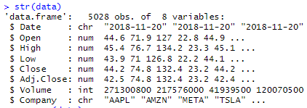
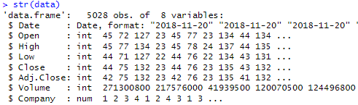
check NULLS
data type before preprocessing
data type after preprocessing

Slide 7
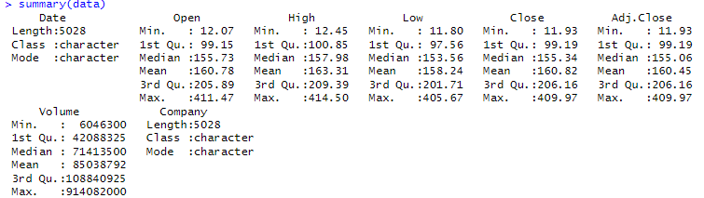
show summary of data

Slide 8
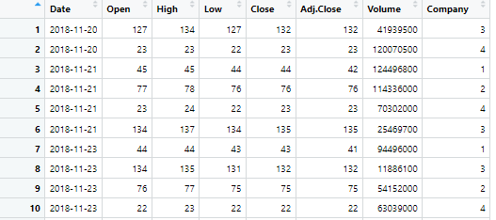
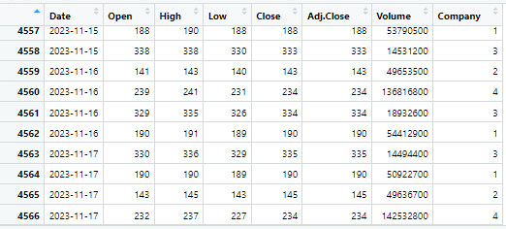

Slide 9
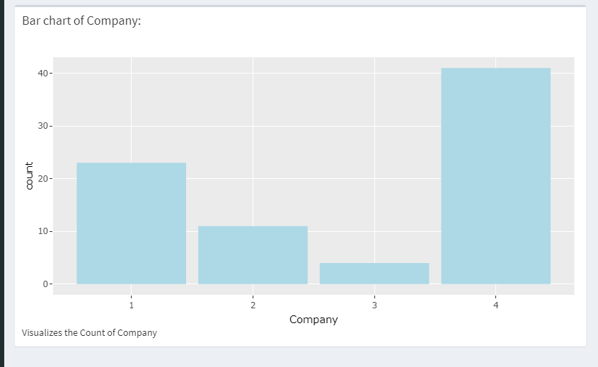
1-Bar chart
Visualizations
Bar chart of Companies Representation that show company number 4 is the highest one

Slide 10
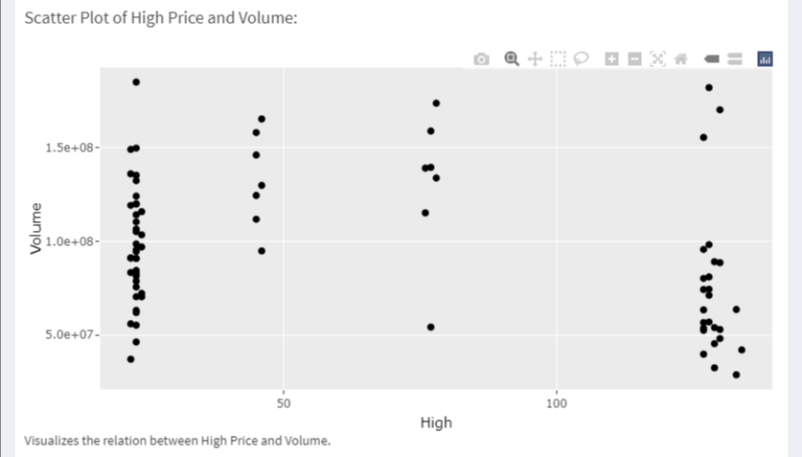
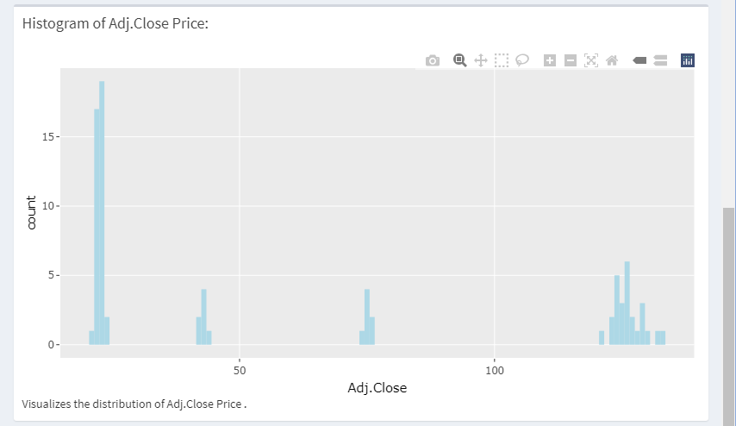
2-Scatter chart
3-Histogram chart
High Price vs. Volume Scatter Plot that show us the most high price for the volume
Distribution of Adjusted Closing Prices“ that show us the highest Adjusted Closing Prices

Slide 11
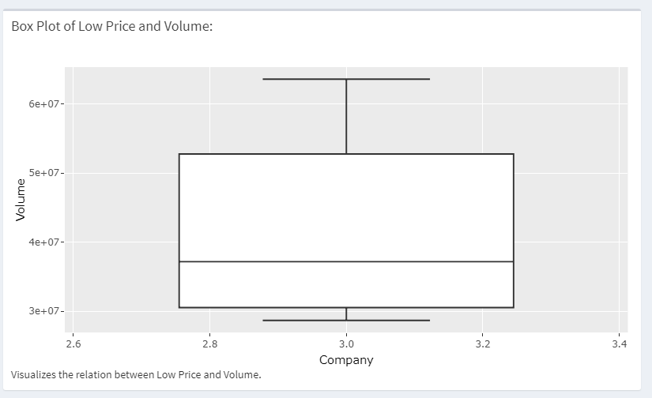
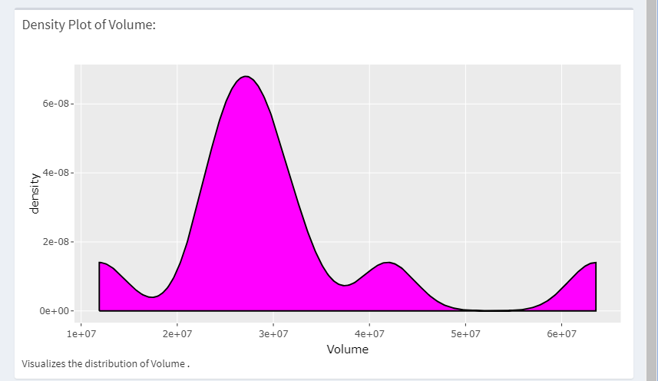
4-Boxplot chart
5-Density chart
Comparison of Low and High Prices that show us Q1 and Q2(median) and Q3
Volume Distribution Density Plot that show us the highest volume

Slide 12
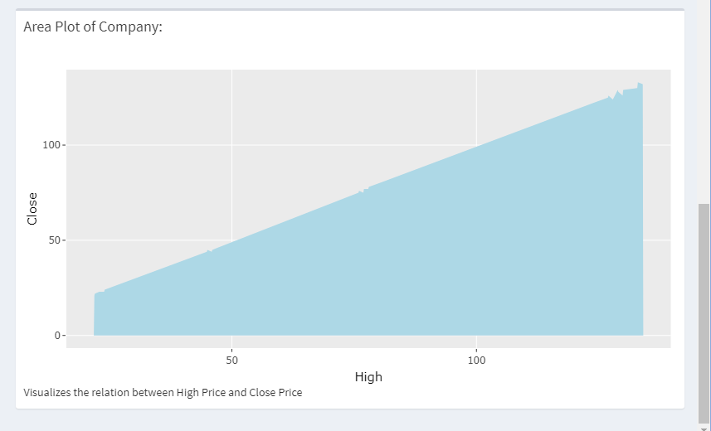
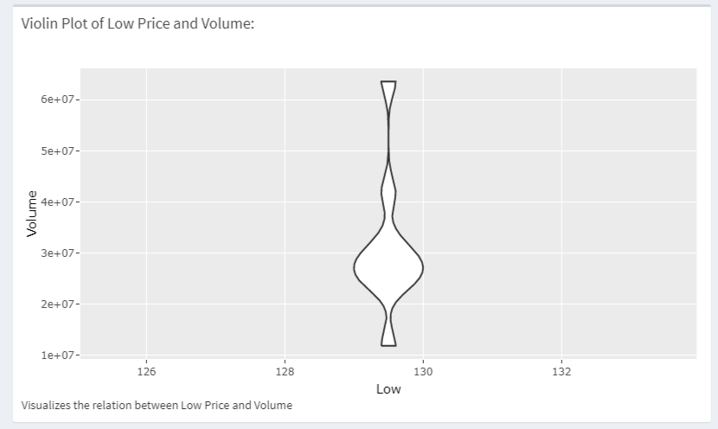
6-Area chart
7-Violin chart
"Price Variation: High vs. Close that show us the difference between High and Close price
Relationship: Low Price and Volume that show us the most low price for the volume

Slide 13
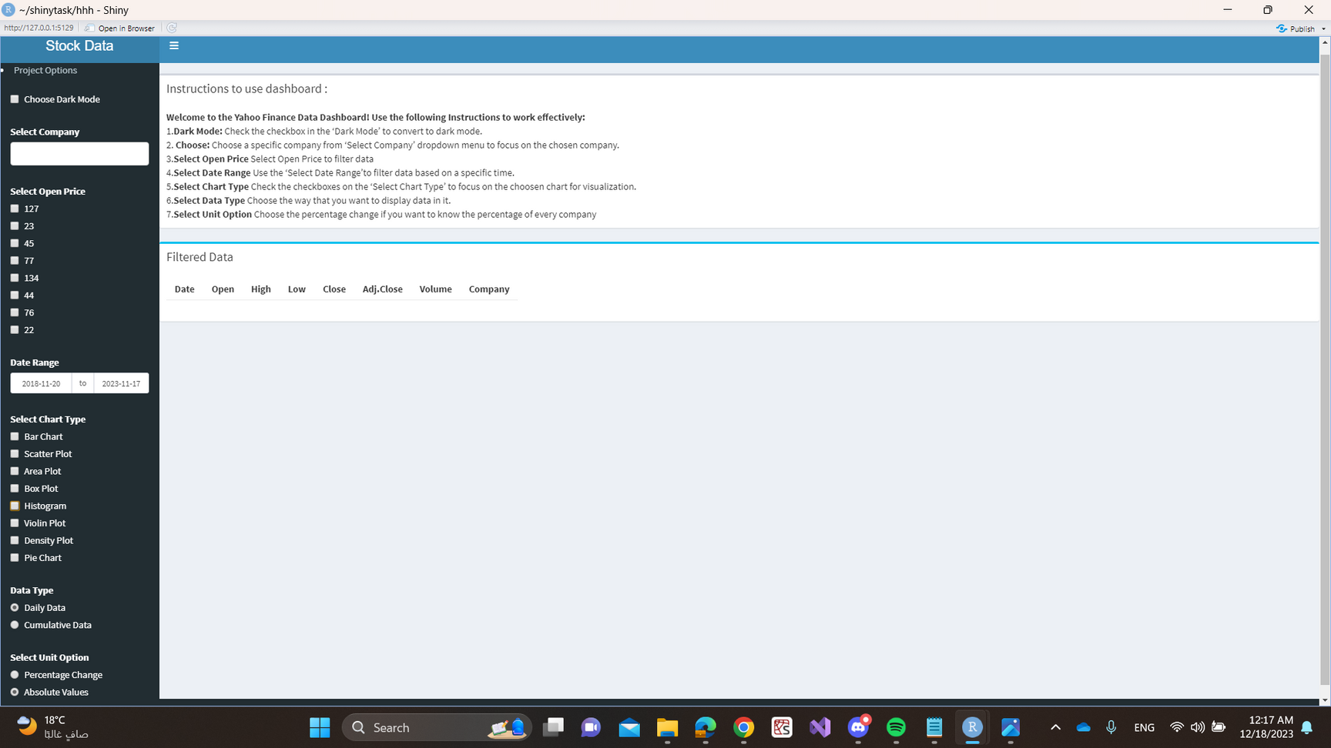
Dash board

Slide 14
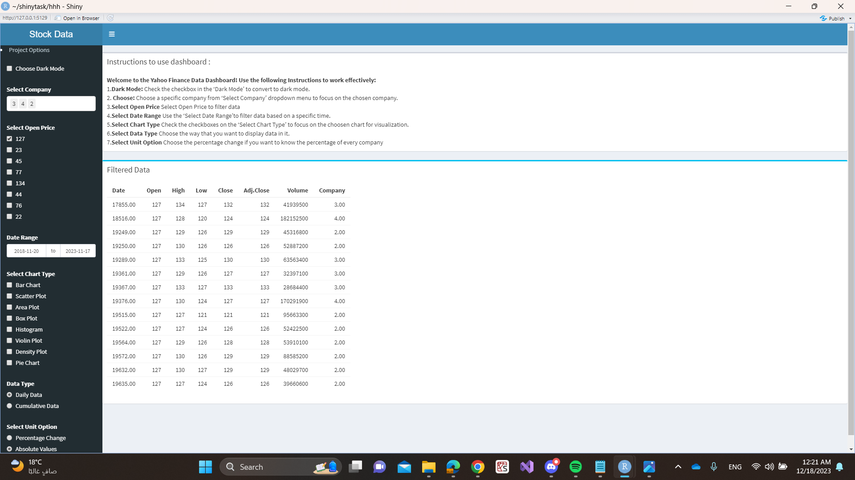
we can filter data based on a selected company from the dropdown list and based on selected open price from the check box

Slide 15
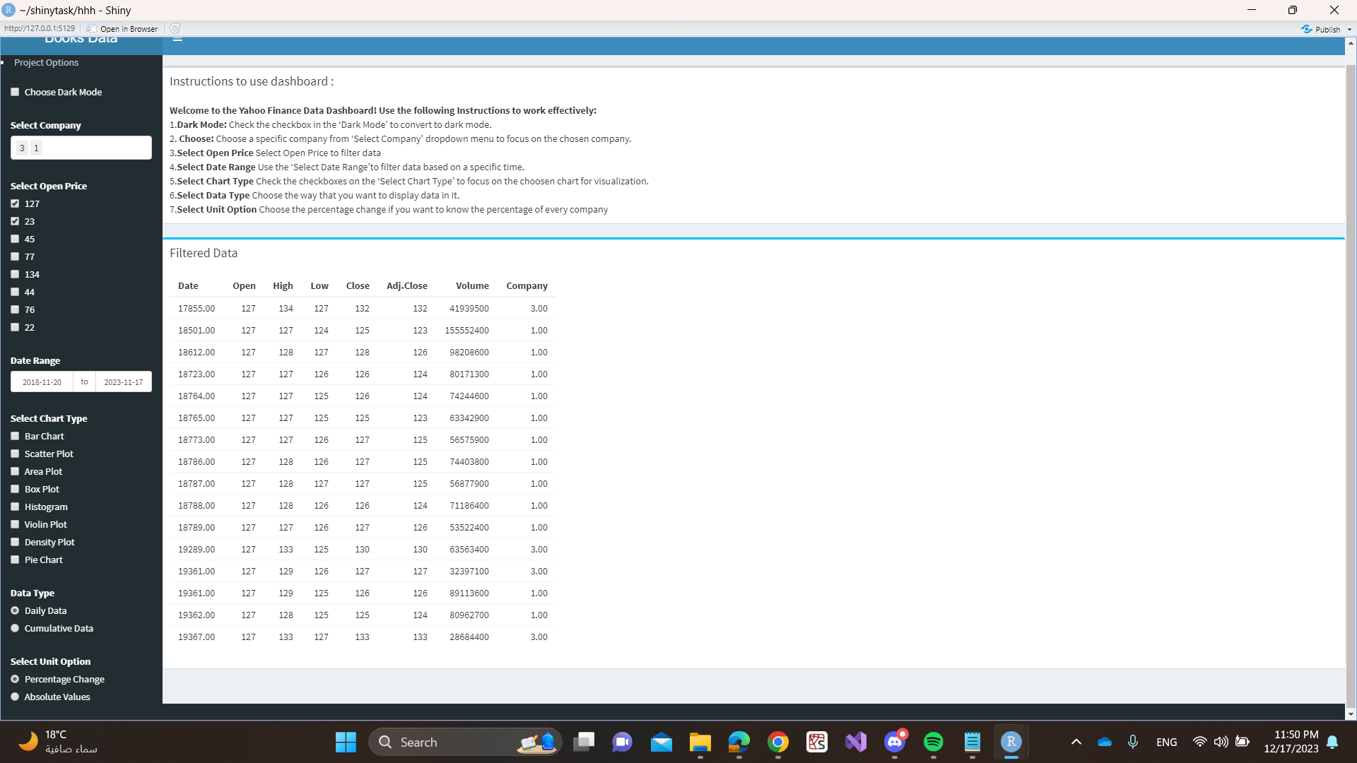

you can choose from the check box data type (daily or cumulative )
Daily Data
Cumulative Data

Slide 16
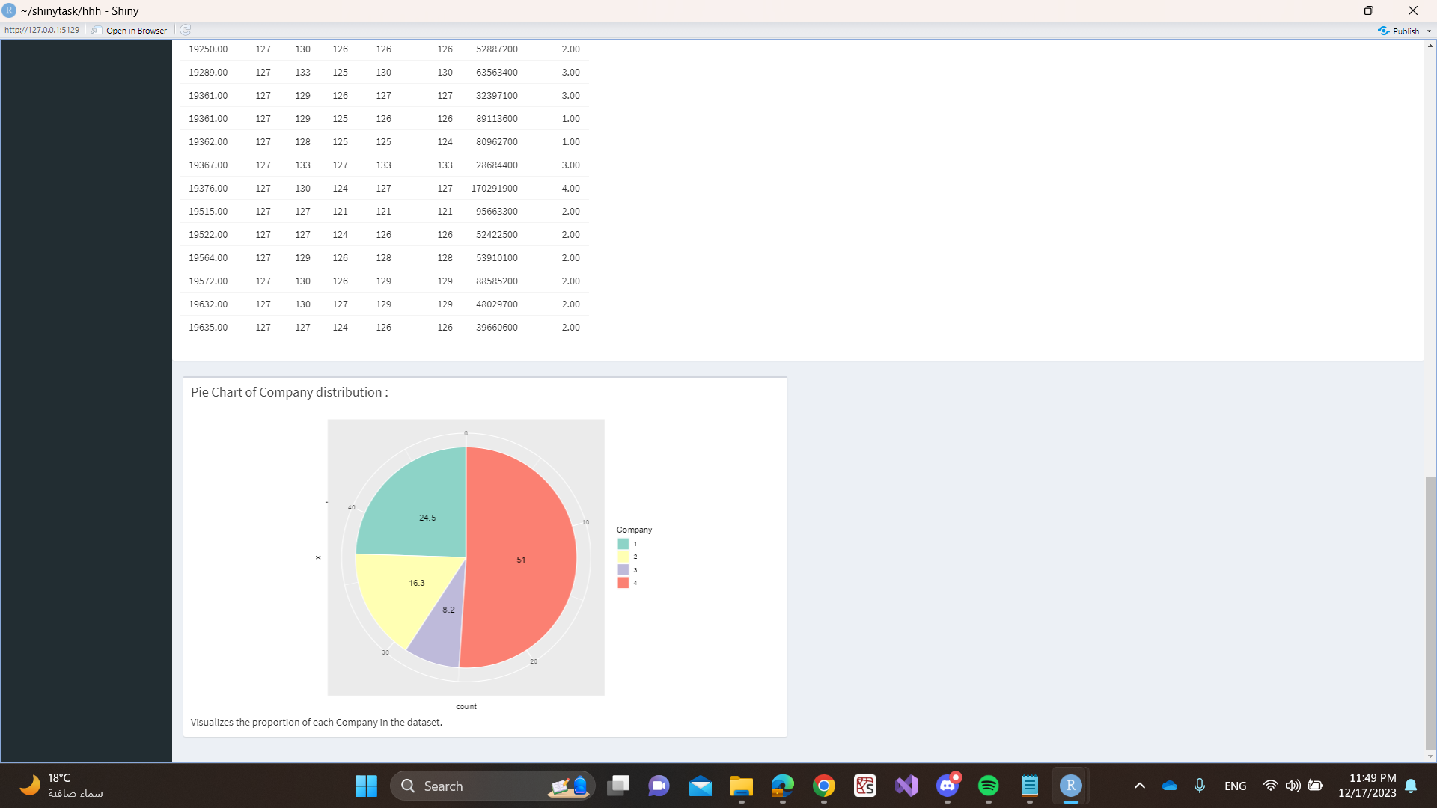

you can choose from the radio button unit option (absolute or percentage )
Percentage Values
Absolute Data

Slide 17
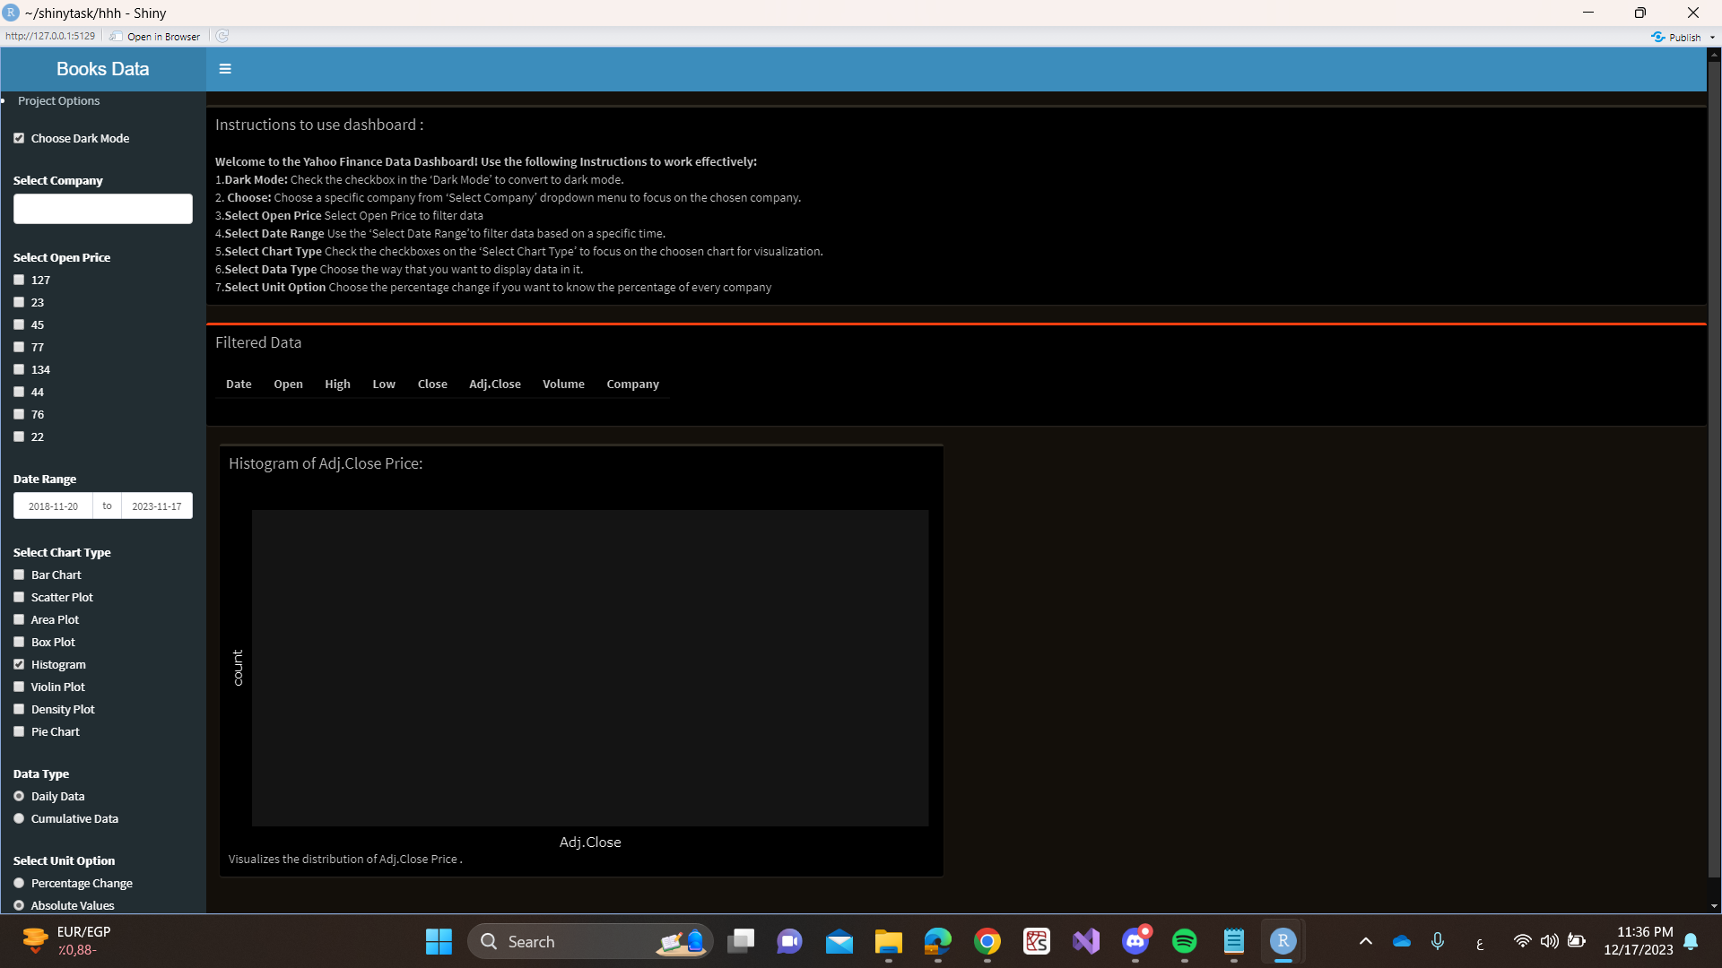
you can make the dashboard on dark mode

Slide 18
THANK YOU

